Slide 1


Introduction to Multimedia
Class 7
Lab 19

Slide 2


What is Multimedia?
Representing information through Audio, Video, Animation etc.
Notes:
Notes to presenter:
Description of what you learned in your own words on one side.
Include information about the topic
Details about the topic will also be helpful here.
Tell the story of your learning experience. Just like a story there should always be a beginning, middle and an end.
On the other side, you can add a graphic that provides evidence of what you learned.
Feel free to use more than one slide to reflect upon your process. It also helps to add some video of your process.

Slide 3




Types of Multimedia
AUDIO
GRAPHIC
01
04
02
Video & Animation
03
TEXT
Notes:
Notes to presenter:
What did you think at first?
What obstacles did you encounter along the way?
How did you overcome those obstacles?
What images can you add to support your process?
This SmartArt allows you add images and text to help outline your process. If a picture is worth a thousand words, then pictures and words should help you communicate this reflection on learning perfectly! You can always click on Insert>SmartArt to change this graphic or select the graphic and click on the Design contextual menu to change the colors.
Feel free to use more than one slide to reflect upon your process. It also helps to add some video of your process.

Slide 4

TEXT

Slide 5

GRAPHIC

Slide 6
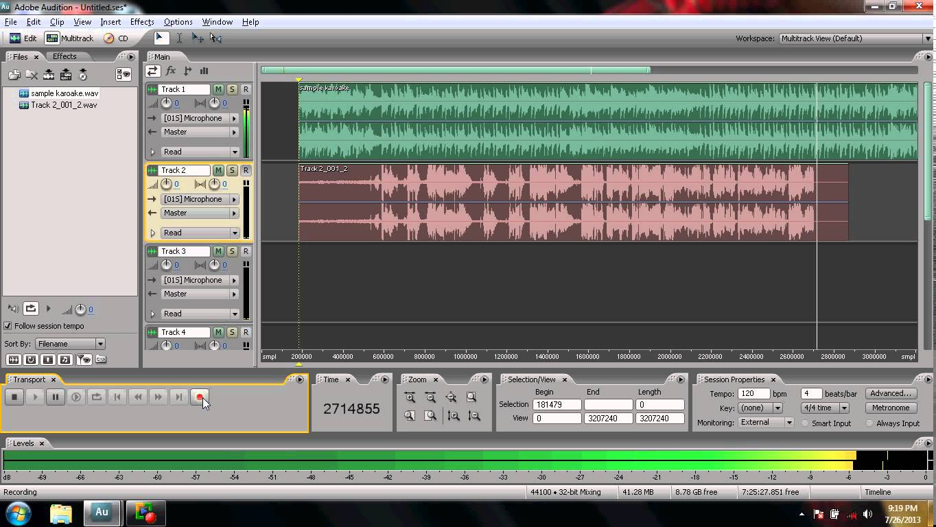

AUDIO

Slide 7
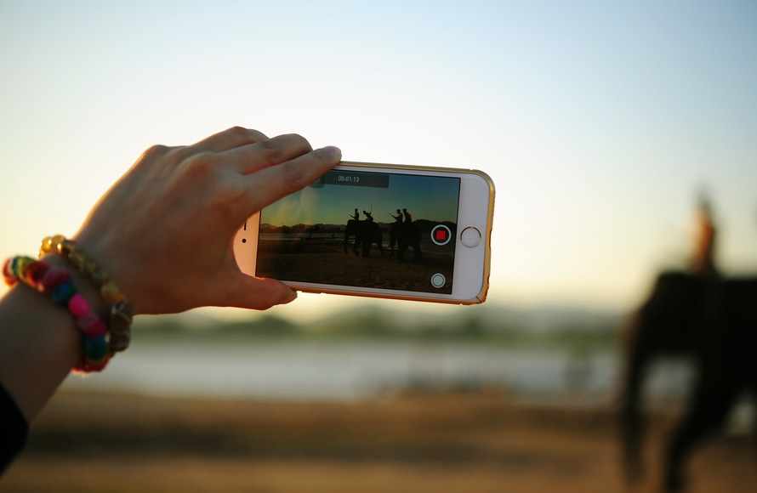
VIDEO

Slide 8

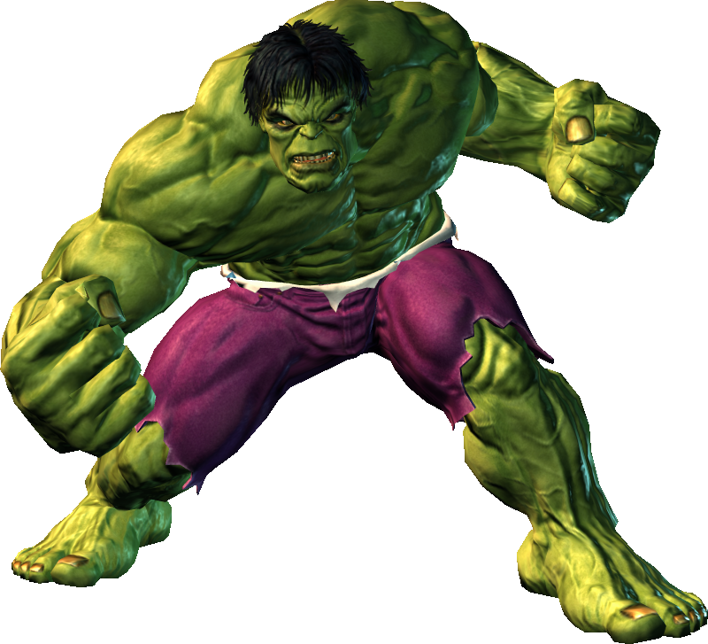
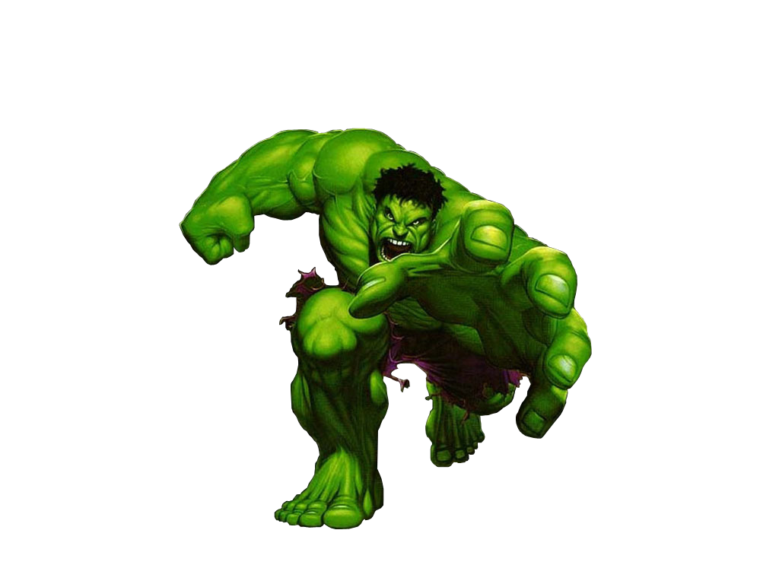
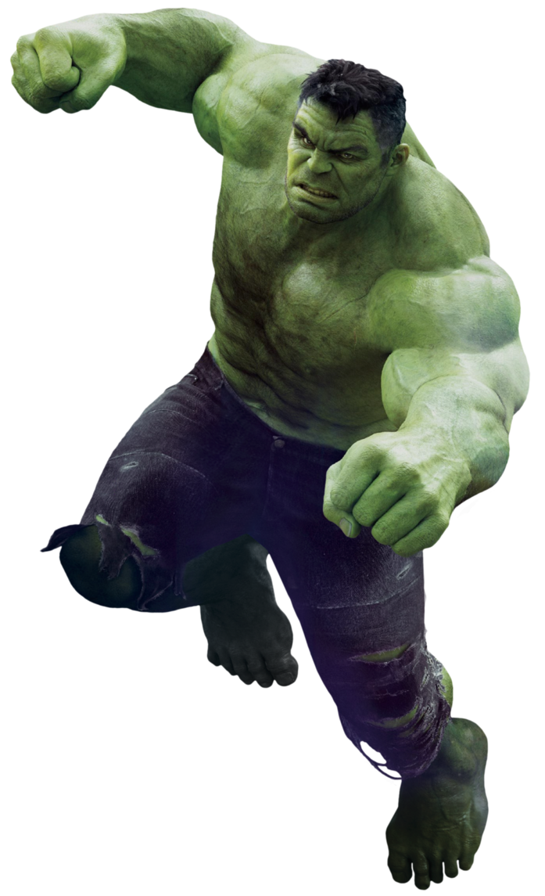
ANIMATION

